Slide 1


BUS 101 Introduction to Business
Sept. 27-29, 2017

Slide 2


Agenda
How Does Lab Sessions Work?
Introduction to BUS 101 Format
BUS 101 Labs
TIKEA Case

Slide 3
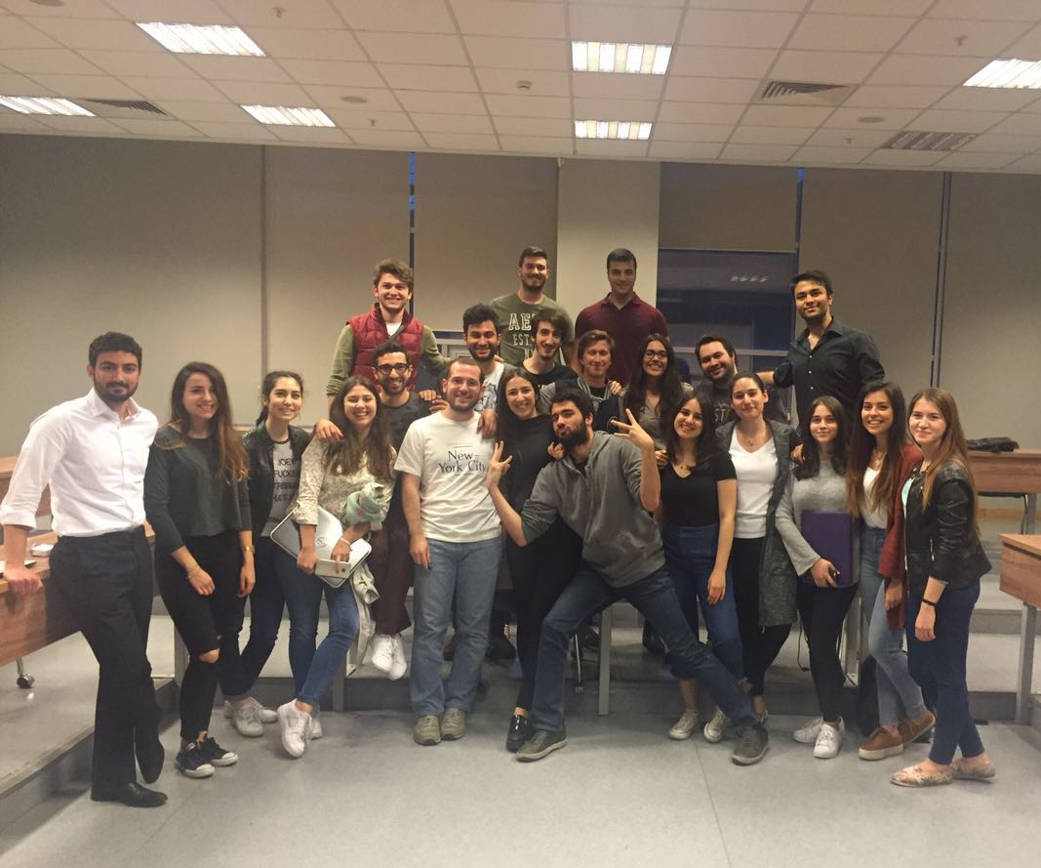
How Does Lab Sessions Work?
Main TA
Co TA
Observer TAs

Slide 4
BUS 101 Format
Lecture
Lab
Focus on Content
Case Discussions
Real-World Examples
2 hour lecture & discussion
Focus on Excel & Practice
Go over practice problems from the lecture
Decision-making results

Slide 5
Objectives of BUS 101 Labs
Over the semester, you will gain:
Critical thinking and problem solving skills
Computer proficiency, especially in Excel
Understanding of different business areas and how they link together

Slide 6
Assessment Breakdown
5 HWs
Pop Quizzes (4)
2 Midterms
1 Final Exam

Slide 7
Homework Assignments
Always due on Wednesday mornings at 9:00 AM
No late assignments will be accepted!
All assignments will be returned to you, graded and with solutions, within 48 hours.
You will have 3 days to object your homework grades.

Slide 8
Midterm Structure
2 Midterms
Delivered at the end of each second module
Covers only the content from those two modules
If you miss an exam, then
Given under medical emergencies →
E-mail to Head Teaching Assistant (melis.kayaciklioglu@ozu.edu.tr) →
Give your VERIFIED medical report on time!

Slide 9
Important Deadlines
Homework Assignment | Weight | Due Date
HW1 - Introduction to Excel | 2% | Oct. 4th
HW2 - Accounting | 5% | Oct. 18th
HW3 - Statistics | 5% | Nov. 1st
HW4 - Forecasting | 5% | Nov. 22nd
HW5 - Finance | 5% | Dec. 6th
Exam | Weight | Date
Midterm #1 | 20% | Nov. 4th
Midterm #2 | 20% | Dec. 9th
Final | 30% | TBA

Slide 10
Computer Lab Terminology
Right click, Left click, Double click
Hover = placing my mouse over top of something but NOT clicking
Drag & Drop = click, hold down, move mouse, then let go
Propagate = copying a formula into many cells at once in Excel
Shortcut keys (eg. ctrl, shift + arrows)

Slide 11
Basic Business Terms
Unit = One product
Price = Money paid for one unit
Unit Cost = Money spent to produce
Unit Profit= Unit Price – Unit Cost
Sales Volume = Usually the # of units sold
Revenue = Money brought in through sales (usually price*number of units sold)
Total Cost = Total variable cost, overhead, S&A, R&D...
Total Profit = Total Revenue – Total Costs

Slide 12
BUS 101- Contact Info
Jason Lau
OFFICE: Tuesdays Mornings 9:00 – 11:00 @FEAS,301
E-MAIL: jason.lau@ozyegin.edu.tr
TWITTER: ceyhunlau
Course
Facebook Page: OzuBus101
Twitter: Bus101HelpDesk
Office: FEAS, G20-G21
E-Mails:
Front Office: bus101.front@gmail.com
Back Office: bus101.backoffice@gmail.com

Slide 13

For Following Week
Please read the Case before coming to class.
Complete and Submit HW1
Wednesday, Oct. 4th , 9:00 a.m.
Ask your questions to bus101.front@gmail.com
bus101.backoffice@gmail.com

Slide 14
Now let’s get started!
Login into the LMS
http://www.lms.ozyegin.edu.tr
Username and Password same as laptop login
Click on BUS 101: Introduction to Business / GARM107 / HMAN107
Course Webpage
Weekly Outline
Important Pages: Schedule, Latest News, Resources, FAQs, Forums, Grades, HELP!

